Slide 1
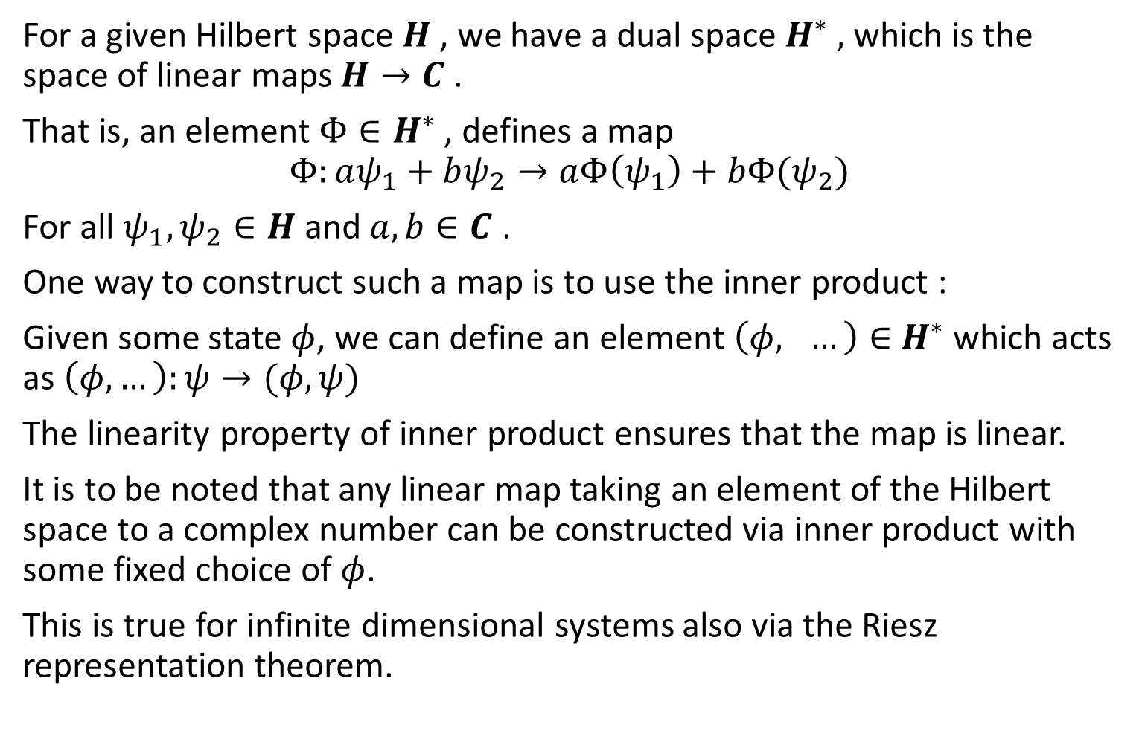
Lecture 3: Dual space
For a given Hilbert space $H$, we have a dual space $H^{∗} ,$ which is the space of linear maps $H→C$ .
That is, an element $Φ∈H^{∗}$ , defines a map
$$Φ:aψ_{1}+bψ_{2}→aΦ\left(ψ_{1}\right)+bΦ(ψ_{2})$$
For all $ψ_{1},ψ_{2}∈H$ and $a,b∈C$ .
One way to construct such a map is to use the inner product :
Given some state $φ$, we can define an element $\left(φ, …\right)∈$ $H^{∗}$ which acts as $\left(φ,…\right):ψ→(φ,ψ)$
The linearity property of inner product ensures that the map is linear.
It is to be noted that any linear map taking an element of the Hilbert space to a complex number can be constructed via inner product with some fixed choice of $φ$.
This is true for infinite dimensional systems also via the Riesz representation theorem.

Slide 2
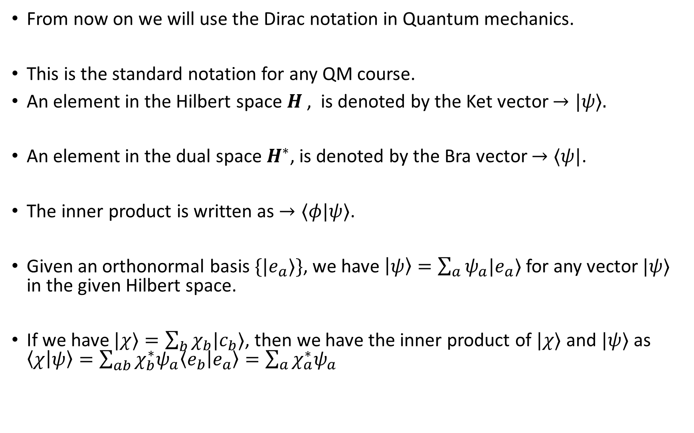
Dirac notation and continuum states
From now on we will use the Dirac notation in Quantum mechanics.
This is the standard notation for any QM course.
An element in the Hilbert space $H$, is denoted by the Ket vector $→|ψ⟩.$
An element in the dual space${ H}^{∗}$, is denoted by the Bra vector $→⟨ψ|$.
The inner product is written as $→⟨φ|ψ⟩$.
Given an orthonormal basis $\{|e_{a}⟩\}$, we have $\left|ψ\right\rangle =\sum_{a}{ψ_{a}|e_{a}⟩}$ for any vector $|ψ⟩$ in the given Hilbert space.
If we have $|χ⟩=\sum_{b}{χ_{b}|c_{b}⟩}$, then we have the inner product of $|χ⟩$ and $|ψ⟩$ as $\left\langle χ | ψ\right\rangle =\sum_{ab}{χ_{b}^{∗}ψ_{a}\left\langle e_{b} | e_{a}\right\rangle =\sum_{a}{χ_{a}^{∗}ψ_{a}}}$

Slide 3
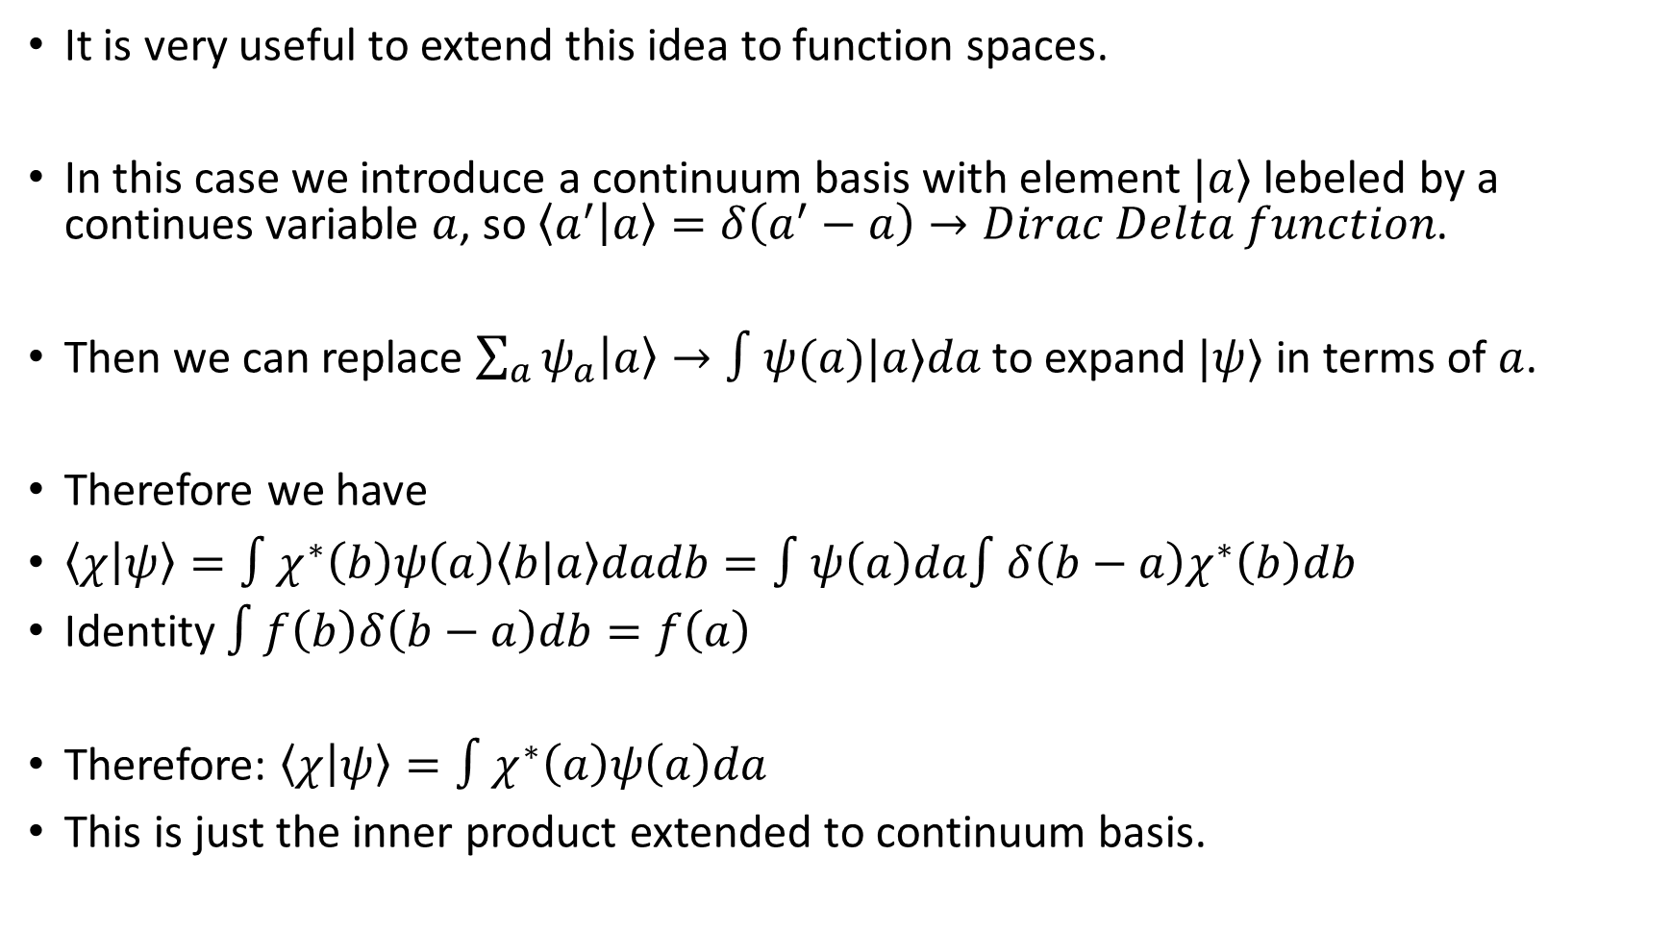
It is very useful to extend this idea to function spaces.
In this case we introduce a continuum basis with element $|a⟩$ lebeled by a continues variable $a$, so $\left\langle a^{′} | a\right\rangle =δ\left(a^{′}−a\right)→Dirac Delta function$.
Then we can replace $\sum_{a}{ψ_{a}\left|a\right\rangle →∫ψ(a)|a⟩da}$ to expand $|ψ⟩$ in terms of $a$.
Therefore we have
$\left\langle χ | ψ\right\rangle =∫χ^{∗}\left(b\right)ψ\left(a\right)\left\langle b | a\right\rangle dadb=∫ψ\left(a\right)da∫δ\left(b−a\right)χ^{∗}\left(b\right)db$
Identity $∫f\left(b\right)δ\left(b−a\right)db=f\left(a\right)$
Therefore: $\left\langle χ | ψ\right\rangle =∫χ^{∗}\left(a\right)ψ\left(a\right)da$
This is just the inner product extended to continuum basis.

Slide 4
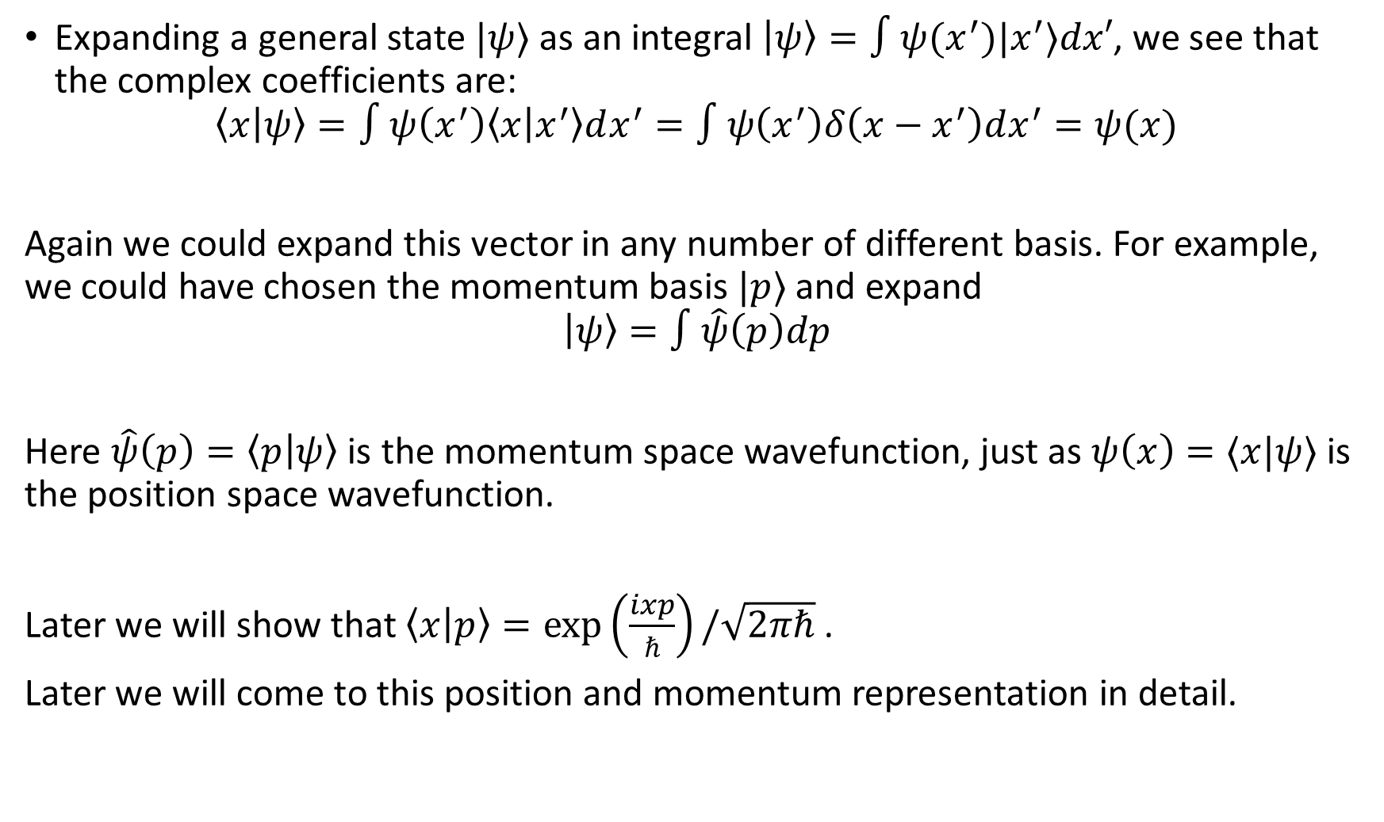
Expanding a general state $|ψ⟩$ as an integral $\left|ψ\right\rangle =∫ψ(x^{′})|x^{′}⟩dx′$, we see that the complex coefficients are:
$$\left\langle x | ψ\right\rangle =∫ψ\left(x^{′}\right)\left\langle x | x^{′}\right\rangle dx^{′}=∫ψ\left(x^{′}\right)δ\left(x−x^{′}\right)dx^{′}=ψ(x)$$
Again we could expand this vector in any number of different basis. For example, we could have chosen the momentum basis $|p⟩$ and expand
$$\left|ψ\right\rangle =∫\hat{ψ}\left(p\right)dp$$
Here $\hat{ψ}\left(p\right)=\left\langle p | ψ\right\rangle$ is the momentum space wavefunction, just as $ψ\left(x\right)=⟨x|ψ⟩$ is the position space wavefunction.
Later we will show that $\left\langle x | p\right\rangle =\exp\left(\frac{ixp}{ℏ}\right)/\sqrt{2πℏ}$ .
Later we will come to this position and momentum representation in detail.

Slide 5
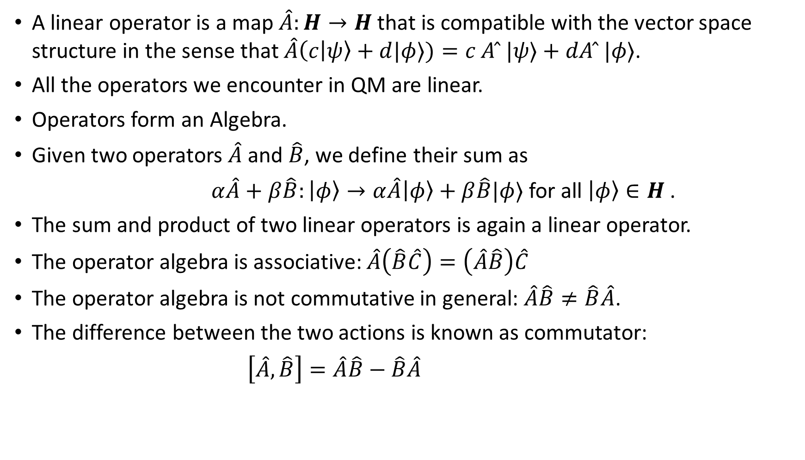
Operators
A linear operator is a map $\hat{A}:H→H$ that is compatible with the vector space structure in the sense that $\hat{A}\left(c | ψ\right\rangle +d|φ⟩)=c A ̂ |ψ⟩+dA ̂ |φ⟩$.
All the operators we encounter in QM are linear.
Operators form an Algebra.
Given two operators $\hat{A}$ and $\hat{B}$, we define their sum as
$α\hat{A}+β\hat{B}:\left|φ\right\rangle →α\hat{A}\left|φ\right\rangle +β\hat{B}|φ⟩$ for all $\left|φ\right\rangle ∈H$ .
The sum and product of two linear operators is again a linear operator.
The operator algebra is associative: $\hat{A}\left(\hat{B}\hat{C}\right)=\left(\hat{A}\hat{B}\right)\hat{C}$
The operator algebra is not commutative in general: $\hat{A}\hat{B}≠\hat{B}\hat{A}$.
The difference between the two actions is known as commutator:
$\left[\hat{A},\hat{B}\right]=\hat{A}\hat{B}−\hat{B}\hat{A}$

Slide 6
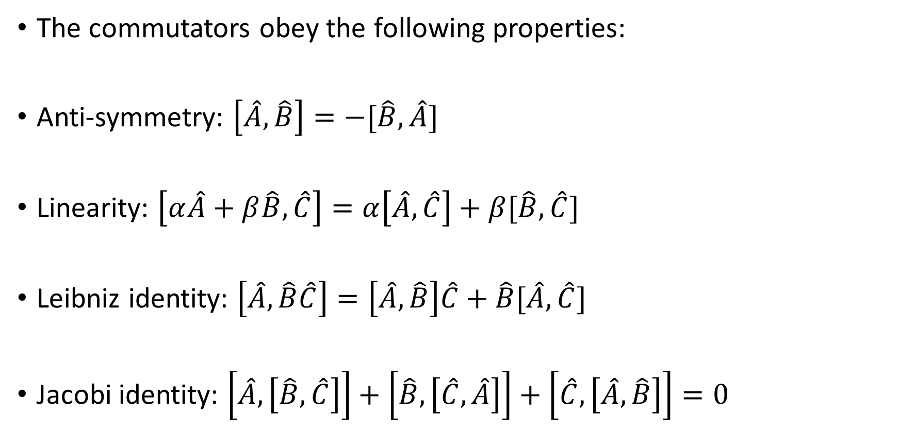
Commutator properties
The commutators obey the following properties:
Anti-symmetry: $\left[\hat{A},\hat{B}\right]=−[\hat{B},\hat{A}]$
Linearity: $\left[α\hat{A}+β\hat{B},\hat{C}\right]=α\left[\hat{A},\hat{C}\right]+β[\hat{B},\hat{C}]$
Leibniz identity: $\left[\hat{A},\hat{B}\hat{C}\right]=\left[\hat{A},\hat{B}\right]\hat{C}+\hat{B}[\hat{A},\hat{C}]$
Jacobi identity: $\left[\hat{A},\left[\hat{B},\hat{C}\right]\right]+\left[\hat{B},\left[\hat{C},\hat{A}\right]\right]+\left[\hat{C},\left[\hat{A},\hat{B}\right]\right]=0$

Slide 7
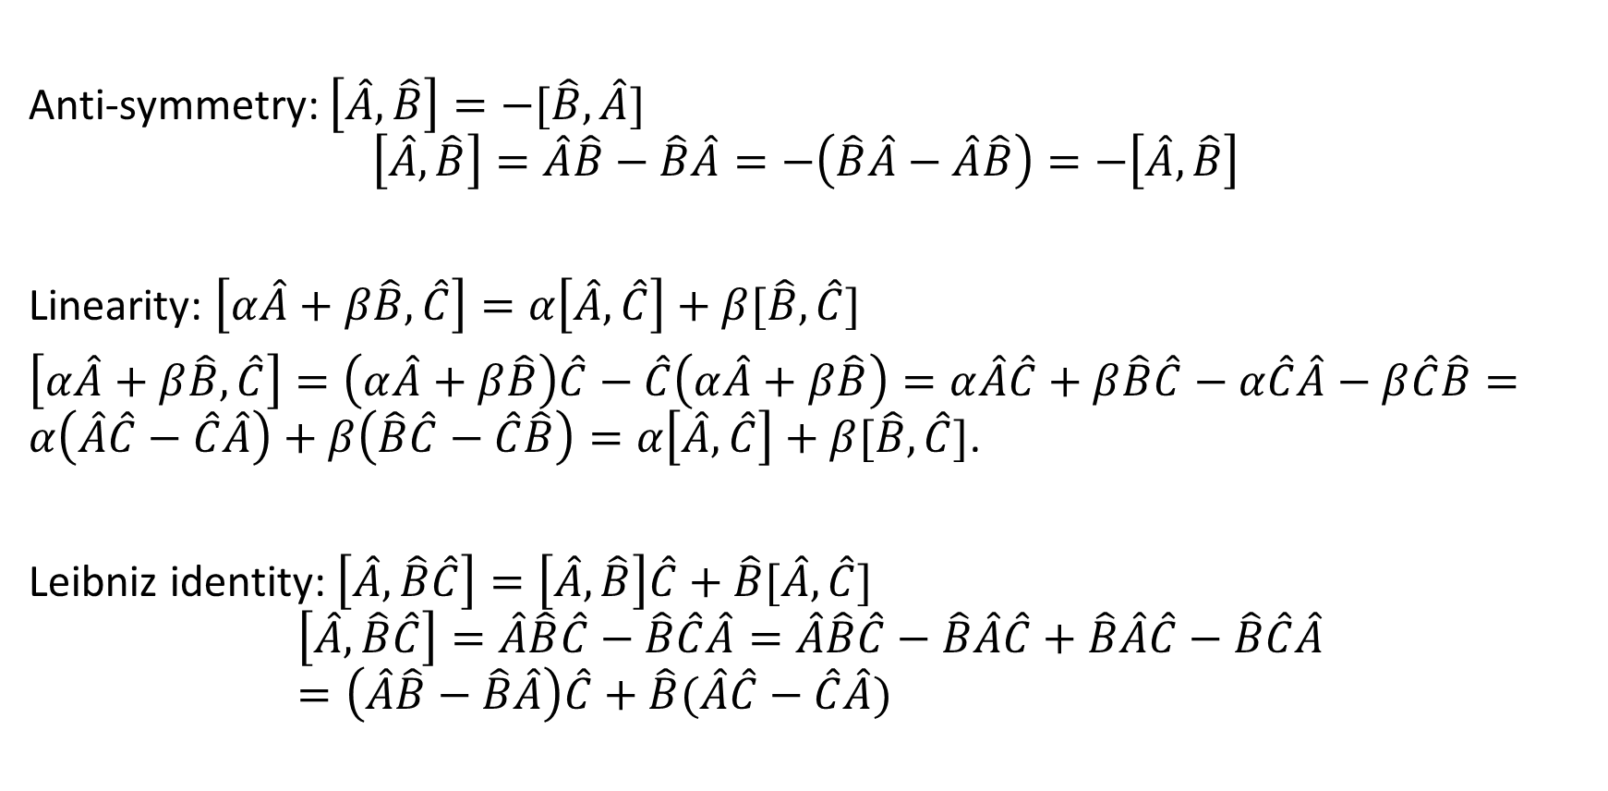
Proof:
Anti-symmetry: $\left[\hat{A},\hat{B}\right]=−[\hat{B},\hat{A}]$
$$\left[\hat{A},\hat{B}\right]=\hat{A}\hat{B}−\hat{B}\hat{A}=−\left(\hat{B}\hat{A}−\hat{A}\hat{B}\right)=−\left[\hat{A},\hat{B}\right]$$
Linearity: $\left[α\hat{A}+β\hat{B},\hat{C}\right]=α\left[\hat{A},\hat{C}\right]+β[\hat{B},\hat{C}]$
$\left[α\hat{A}+β\hat{B},\hat{C}\right]=\left(α\hat{A}+β\hat{B}\right)\hat{C}−\hat{C}\left(α\hat{A}+β\hat{B}\right)=α\hat{A}\hat{C}+β\hat{B}\hat{C}−α\hat{C}\hat{A}−β\hat{C}\hat{B}=α\left(\hat{A}\hat{C}−\hat{C}\hat{A}\right)+β\left(\hat{B}\hat{C}−\hat{C}\hat{B}\right)=α\left[\hat{A},\hat{C}\right]+β[\hat{B},\hat{C}]$.
Leibniz identity: $\left[\hat{A},\hat{B}\hat{C}\right]=\left[\hat{A},\hat{B}\right]\hat{C}+\hat{B}[\hat{A},\hat{C}]$
$$\left[\hat{A},\hat{B}\hat{C}\right]=\hat{A}\hat{B}\hat{C}−\hat{B}\hat{C}\hat{A}=\hat{A}\hat{B}\hat{C}−\hat{B}\hat{A}\hat{C}+\hat{B}\hat{A}\hat{C}−\hat{B}\hat{C}\hat{A}=\left(\hat{A}\hat{B}−\hat{B}\hat{A}\right)\hat{C}+\hat{B}(\hat{A}\hat{C}−\hat{C}\hat{A})$$

Slide 8
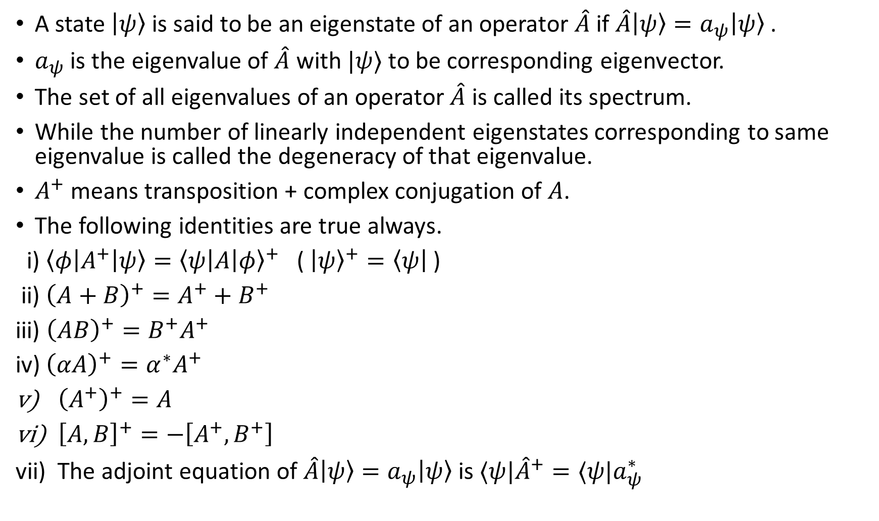
A state $\left|ψ\right\rangle$is said to be an eigenstate of an operator $\hat{A}$ if $\hat{A}\left|ψ\right\rangle =a_{ψ}\left|ψ\right\rangle$ .
$a_{ψ}$ is the eigenvalue of $\hat{A}$ with $|ψ⟩$ to be corresponding eigenvector.
The set of all eigenvalues of an operator $\hat{A}$ is called its spectrum.
While the number of linearly independent eigenstates corresponding to same eigenvalue is called the degeneracy of that eigenvalue.
$A^{+}$ means transposition + complex conjugation of $A$.
The following identities are true always.
i) $\left\langle φ\left|A^{+}\right|ψ\right\rangle ={\left\langle ψ\left|A\right|φ\right\rangle }^{+}$ ( ${\left|ψ\right\rangle }^{+}=\left\langle ψ\right|$)
ii) ${\left(A+B\right)}^{+}=A^{+}+B^{+}$
iii) ${\left(AB\right)}^{+}=B^{+}A^{+}$
iv) ${\left(αA\right)}^{+}=α^{∗}A^{+}$
${\left(A^{+}\right)}^{+}=A$
${\left[A,B\right]}^{+}=−\left[A^{+},B^{+}\right]$
vii) The adjoint equation of $\hat{A}\left|ψ\right\rangle =a_{ψ}\left|ψ\right\rangle$ is $⟨ψ|{\hat{A}}^{+}=⟨ψ|a_{ψ}^{∗}$

Slide 9
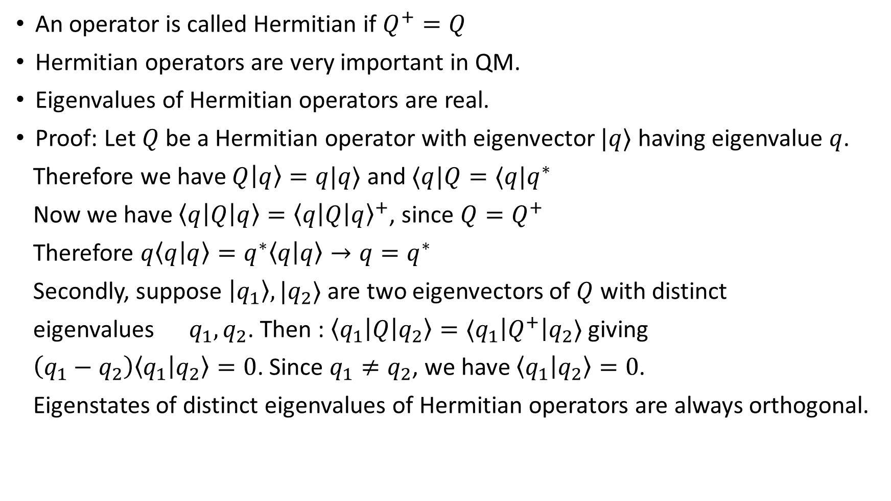
Hermitian operators
An operator is called Hermitian if $Q^{+}=Q$
Hermitian operators are very important in QM.
Eigenvalues of Hermitian operators are real.
Proof: Let $Q$ be a Hermitian operator with eigenvector $|q⟩$ having eigenvalue $q$.
Therefore we have $Q\left|q\right\rangle =q|q⟩$ and $⟨q|Q=⟨q|q^{∗}$
Now we have $\left\langle q\left|Q\right|q\right\rangle ={\left\langle q\left|Q\right|q\right\rangle }^{+}$, since $Q=Q^{+}$
Therefore $q\left\langle q | q\right\rangle =q^{∗}\left\langle q | q\right\rangle →q=q^{∗}$
Secondly, suppose $\left|q_{1}\right\rangle ,|q_{2}⟩$ are two eigenvectors of $Q$ with distinct
eigenvalues $q_{1},q_{2}$. Then : $\left\langle q_{1}\left|Q\right|q_{2}\right\rangle =⟨q_{1}\left|Q^{+}\right|q_{2}⟩$ giving
$\left(q_{1}−q_{2}\right)\left\langle q_{1} | q_{2}\right\rangle =0$. Since $q_{1}≠q_{2}$, we have $\left\langle q_{1} | q_{2}\right\rangle =0$.
Eigenstates of distinct eigenvalues of Hermitian operators are always orthogonal.

